Slide 1
Recalls & Defects Classification Contest
2조
임석빈, 박민우
Fall 2015

Slide 2
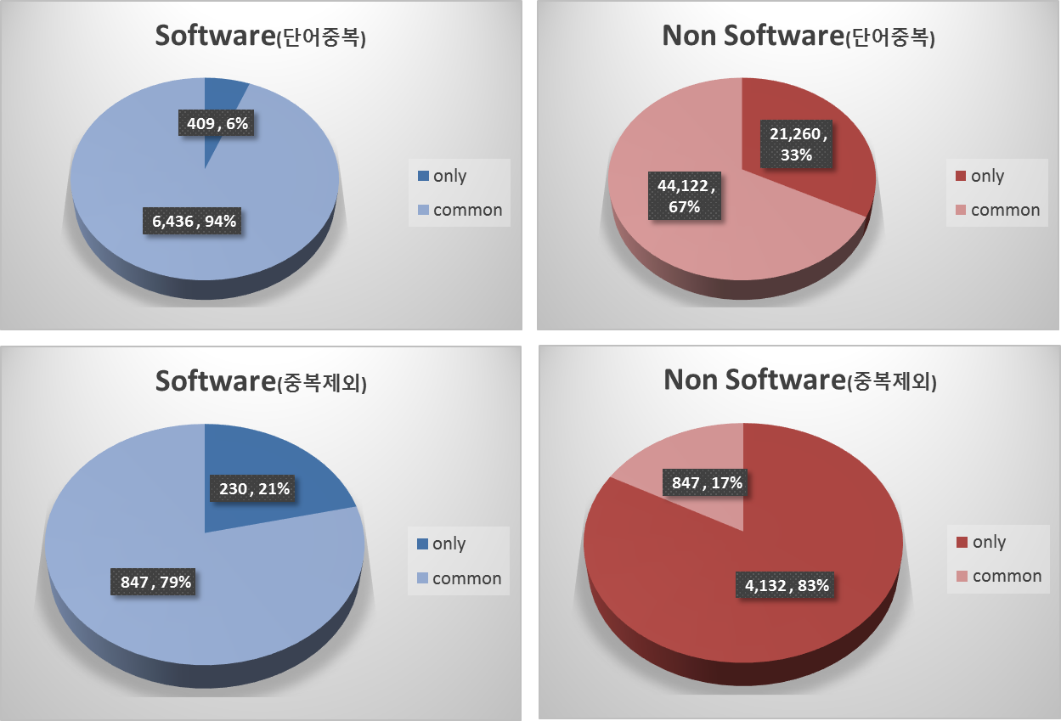
Data Analysis
Software Recall vs. Non Software Recall

Slide 3
Filters
Stop Words and Character
Source : NLTK, Python Stop Woard Library, Self-Defined
Special Character : !"#$%&()*+,./:;<=>?[\]^_`{|}~-@'
Short Word & Unusual Words
Word Length : below 7
Count : 1

Slide 4


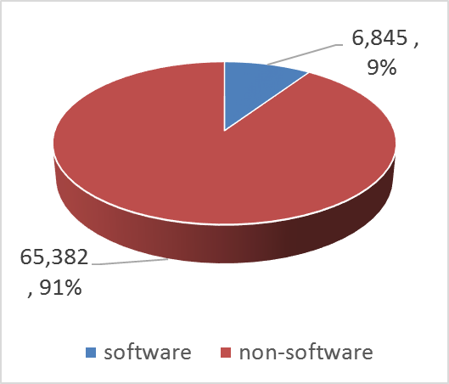
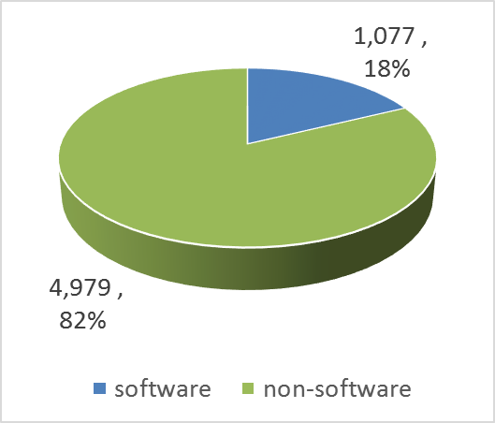
Naïve Bayesian
Multinomial
Bernoulli

Slide 5
Feature Selection
Identify transformed data to improve the accuracy
상대적으로 Software Recall에 더 자주 나타난 단어를 Feature로 선택
words | software | non | total | software/non
update | 42 | 0 | 42 | 43.00000
software | 79 | 2 | 81 | 26.66667
tpms | 19 | 0 | 19 | 20.00000
monitoring | 11 | 0 | 11 | 12.00000
programming | 7 | 0 | 7 | 8.00000
tesla | 7 | 0 | 7 | 8.00000
pscm | 7 | 0 | 7 | 8.00000
reprogram | 15 | 1 | 16 | 8.00000
signal | 14 | 1 | 15 | 7.50000
raise | 6 | 0 | 6 | 7.00000

Slide 6
Results
True Positive : 32
15E011000, 15E033000, 15V008000, 15V011000, 15V015000, 15V038000, 15V041000, 15V064000, 15V075000, 15V085000
15V093000, 15V100000, 15V137000, 15V145000, 15V164000, 15V175000, 15V179000, 15V200000, 15V202000, 15V206000
15V214000, 15V218000, 15V248000, 15V262000, 15V274000, 15V275000, 15V276000, 15V280000, 15V281000, 15V288000
15V296000, 15V301000
Error : 7
15V120000, 15V177000, 15V143000, 15V148000, 15E030000, 15V094000, 15V227000
Missed : 4
15V013000, 15V043000, 15V045000, 15V046000

Slide 7

Results
Accuracy : 96.85%
$\frac{\sum{True Positive}+ \sum{True Negative}}{\sum{Total Population}}$ = $\frac{32+306}{349}$
 | Condition Positive | Condition Negative
Test Outcome Positive | True Positive 32 | False Positive 7
Test Outcome Negative | False Negative 4 | True Negative 306

Slide 8

Results
정확도 개선을 위한 단어 추천
False (Negative/Positive) 판정 시, 가중치를 적용할 수 있는 단어 추천
Accuracy : 98.28%
$\frac{\sum{True Positive}+ \sum{True Negative}}{\sum{Total Population}}$ = $\frac{33+310}{349}$
 | Condition Positive | Condition Negative
Test Outcome Positive | True Positive 33 | False Positive 3
Test Outcome Negative | False Negative 3 | True Negative 310

